Slide 1
TERM Create easy way to utilize Quantum Circuit on Unity
B3 ryom

Slide 2
Background : Unity and Quantum Game
Unity
The “Game Engine” which allows Everyone to make game.
Quantum Game
Very young Genre of computer game which uses Quantum Computer.
Term project → Provides Easy way to Setup and run Quantum Circuit

Slide 3
Why Quantum Game? Why Unity?
Why Quantum Game?
Because…
I’m very curious about how Game will change with Quantum Computer.
Why Unity?
Because…
It could be Entry for Quantum Game for many people.

Slide 4
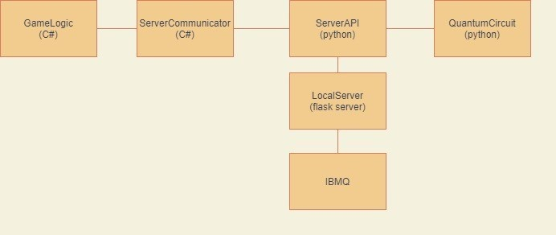
Qiskit Unity Asset
QuantumGame → Game that uses Quantum Computer
Only tool to make Quantum Circuit available on Unity

Slide 5
QiskitUnityAsset: Difficultys
Problems that “Qiskit Unity Asset”has.
Can not make game Standalone
Need to know “QASMString” to build quantum circuit.
Complex setup
APIs are not overraped

Slide 6
Quantum Circuit for Unity

Slide 7
Features of Quantum for Unity
Easy Setup
Easy Implementing
High Expandability What Have been improved?(Compared to Conventional Qiskit Asset)

Slide 8
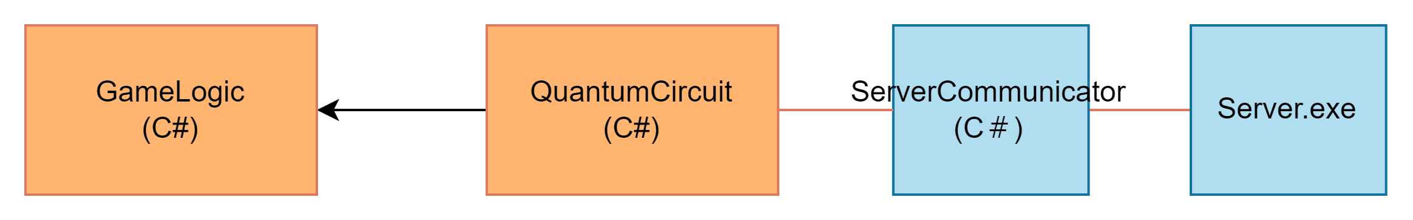
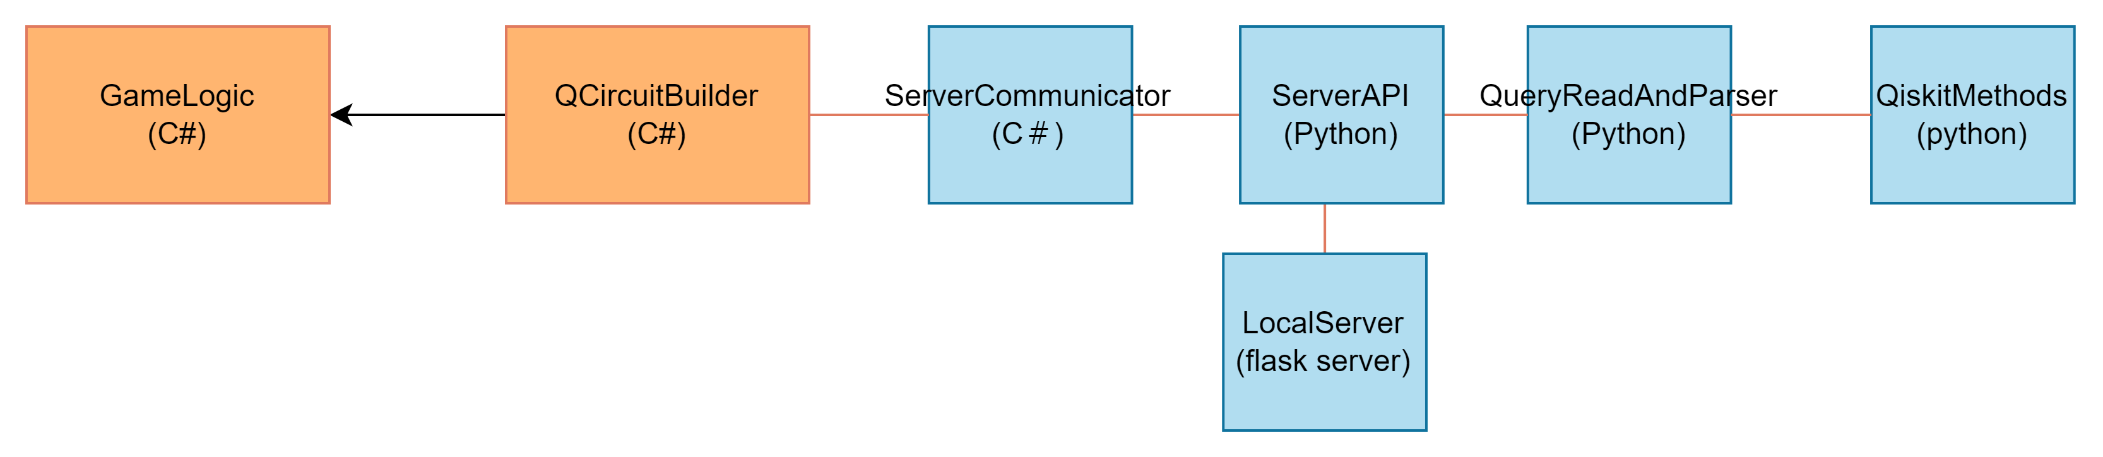
Easy Setup
Quantum Circuit for Unity Will…
Automatically Convert .py file to .exe file including all depending Library
Automatically Run Local Server internally.
→Can make Standalone Build

Slide 9
Easy setup :Steps to setup
Open your Unity Project
Double click QuantumCircuitForUnity.unitypackage then wait until it is loaded to your project.
Push “Import” on popup window
Wait till Auto Setup end.
Place “Router” prefab to your project
You can find Router under “Plugins/QiskitUtilityAsset/Pref”
Done

Slide 10
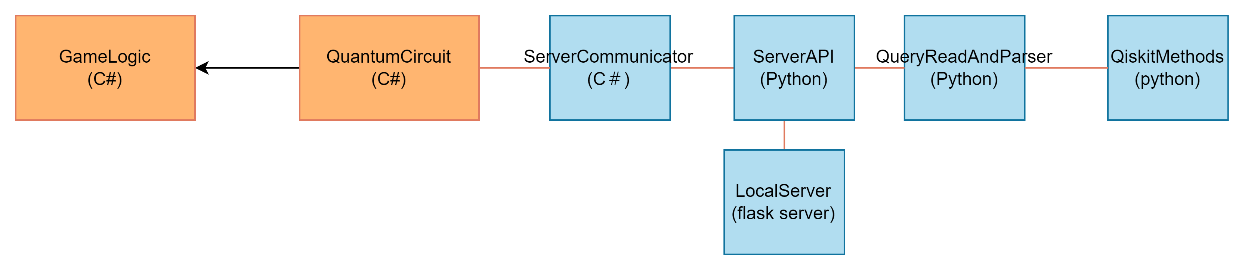
Easy Implementing
Using Class: “Quantum Circuit”
Developers will easily build quantum circuit intuitively.
Will Internally Communicate with server and
No need to know “QASMString” or “Qiskit”

Slide 11
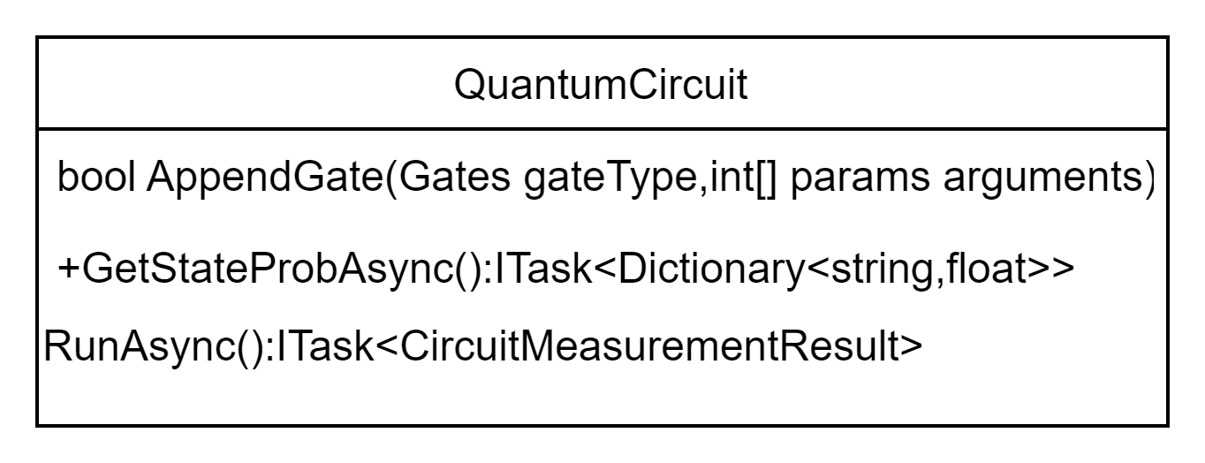
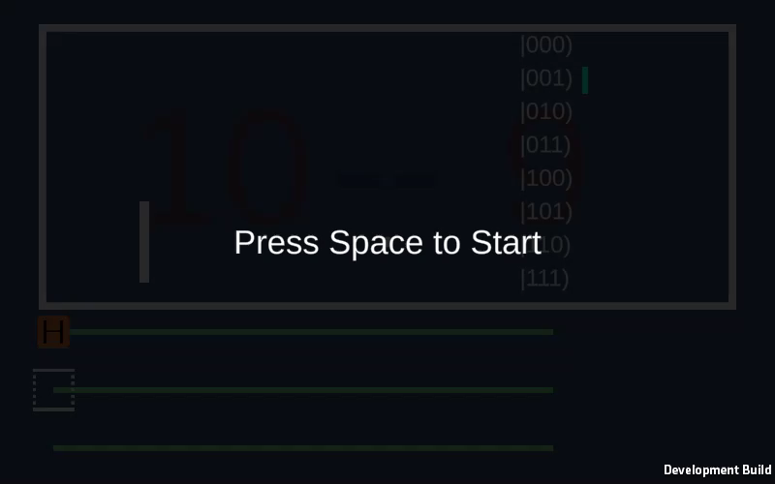
Class:QuantumCircuit
CircuitMeasurementResultのフィールドは以下の通り
Raw Result (Dictionary<string,int>): 各状態が観測された回数
Total Shots (int): 実行＆観測を行った回数
Bit Length (int): 回路のqubit数
Max States (int[]): 最大数観測された状態
Max Count (int): 上の状態が観測された回数
QBitProbs (): 各状態においてどのQubitがどの程度の頻度で現れたか。

Slide 12
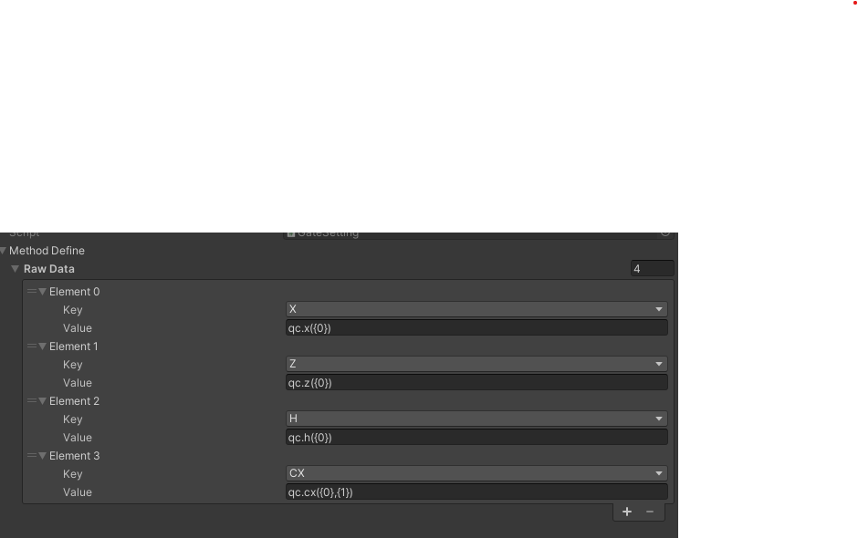
High Expandability
You Can Customize public bool AppendGate(Gates type, params object[] arguments)
With “Gate Setting” to make other Qiskit Methods Avalable on Unity.

Slide 13
Problems
There are not much people making Quantum Game. → Could not find people for Testrun. →I will introduce this asset at next Quantum Game jam to take survey
Data Volume is too big, due to embedded server.

